Slide 1
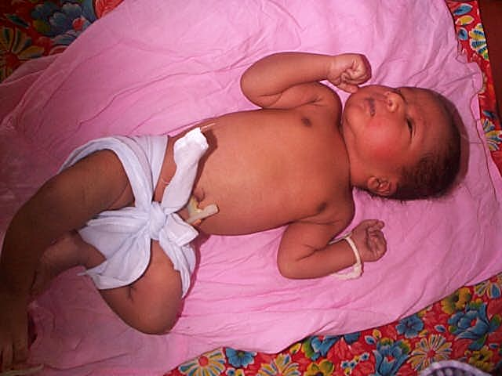
Common Congenital Abnormalities
Prof. Asvini D Fernando
Department of Paediatrics

Slide 2
Definition
Congenital: A condition that is present at birth
1. Existing at or before birth usually through heredity
2. Acquired at birth or during uterine development, usually as a result of environmental influences
Congenital anomalies
structural functional anomalies including metabolic disorders

Slide 3
Size of the Problem
Congenital anomalies affect approximately 1 in 33 infants
Approximately 3.2 million birth defect-related disabilities very year
Deaths
An estimated 270 000 newborns die during the first 28 days of life every year from congenital anomalies
Long-term disability
Significant impact on individuals, families, health-care systems and societies

Slide 4
Aetiology
Genetic and environmental factors
In approximately 50% no cause can be identified

Slide 5
Causes and risk factors
Risk factors
Socioeconomic factors
Indirect determinant. More frequent among resource poor families and countries
Mothers are more susceptible to malnutrition (macronutrient and micronutrient)
Increased exposure to agents or factors that increases the incidence of abnormal prenatal development, particularly infection and alcohol
Advanced maternal age - increases the risk of some chromosomal abnormalities including Down syndrome

Slide 6
Aetiology
Genetic factors
Consanguinity: increases the prevalence of rare genetic congenital anomalies
nearly doubles the risk for neonatal and childhood deaths, intellectual disability and serious birth anomalies
Infections
Maternal infections such as syphilis and rubella

Slide 7
Aetiology
Maternal nutritional status
Iodine deficiency, folic acid insufficiency and diabetes mellitus are linked to some congenital anomalies.
e.g. folate insufficiency neural tube defects
Environmental factors
Maternal exposure to pesticides, medicines, drugs, alcohol, tobacco, certain chemicals, high doses of vitamin A during the early pregnancy, and high doses of radiation. Working or living near or in waste sites, smelters, or mines may also be a risk factor

Slide 8
Prevention
Many birth anomalies can be prevented
Primary prevention of congenital anomalies involves:
Improving the diet of women throughout their reproductive years, ensuring an adequate dietary intake of vitamins and minerals such as folic acid and iodine
Restricting harmful substances alcohol and smoking
Controlling pre-conceptional and gestational diabetes

Slide 9
Prevention
Avoiding exposure to hazardous environmental substances (e.g. heavy metals, pesticides, some medicinal drugs) during pregnancy
Improving vaccination coverage rubella vaccine This can be prevented through childhood vaccination. If not least 1 month prior to pregnancy to women who are not already immune
Increasing and strengthening education to health staff and others interested in promoting birth defects prevention

Slide 10
Detection
Screening can be conducted during the following three periods:
Preconception screening to identify persons at risk for specific disorders or at risk for passing one on to their children. The use of family histories and carrier screening. Valuable in countries where consanguineous marriages are common
Antenatal screening for advanced maternal age, Rhesus blood group incompatibility, and carrier screening
Ultrasound - used to detect Down syndrome and serious fetal anomalies
maternal serum screening can also be used for detection of Down syndrome and neural tube defects during the first and second trimesters

Slide 11
Detection
Newborn screening
Clinical examination
Screening for haematological, metabolic, and hormonal disorders.
Screening for deafness and heart defects and early detection of birth defects
deliver in health facilitates with life-saving treatment and prevent the progression towards some physical, intellectual, visual or auditory disabilities

Slide 12
Common Congenital Abnormalities

Slide 13
Congenital Abnormalities
Head, face and neck
Skin
Cardio-respiratory system
Gastro-intestinal system
Central nervous system
Limbs

Slide 14
Congenital abnormalities of:
Head
Face
Neck

Slide 15
Head, Face and Neck
Cephalhaematoma
Caput succadeneum / chignon
Absent red reflex
Cleft lip / palate
Sternomastoid tumour / neck pathologies
Tongue tie

Slide 16


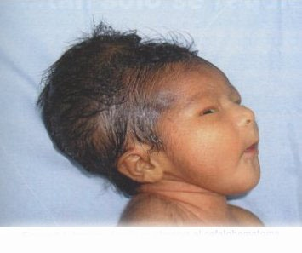
Cephalhaematoma
  Sub-periosteal haemorrhage
  Does not cross suture lines
  Can calcify
Caput succadeneum / chignon
  Prolonged labour / vacuum
  Subcutaneous odema
  Crosses suture lines

Slide 17


Absent pupillary red reflex
Causes of leukocoria (white pupillary reflex)
  Cataract
  Retinoblastoma
  Chorioretinitis
  Retinopathy of prematurity
  Toxocara
  Persistent hyperplastic primary vitreous
Management
  Immediate ophthalmological referral

Slide 18
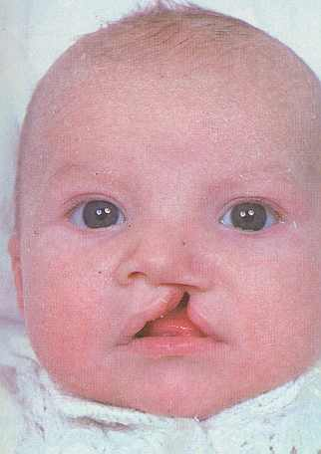
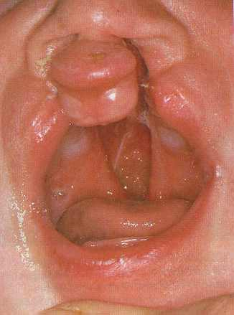
Cleft lip / palate
Incidence / aetiology
  Cleft lip (±cleft palate) = 1: 700 - 750
  Cleft palate alone = 1: 2500
  Mainly genetic; Cleft lips are commoner in males
Clinical manifestations
Small notch in vermillion border
to complete separation up to
floor of nose

Slide 19
Cleft lip / palate
Complications
  Feeding difficulties / aspiration
  Speech problems
  Recurrent middle ear infections / hearing problems
Management
  Special teats for feeding
  Multi disciplinary – orthodontist, speech therapist, ENT surgeon, audiologist, plastic surgeon
  Surgical repair: lip - 3 months; palate – 6-15 months

Slide 20
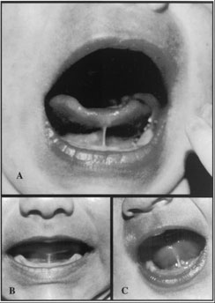
Tongue tie
  Short lingual frenulum
  May have difficulty in breast feeding
  No speech problem

Slide 21
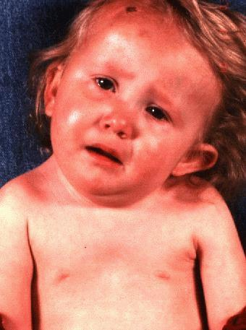
Sternomastoid Tumour
Commonest cause of torticollis in childhood
Cause – unknown
More common in babies born by breech delivery
Pathology:
  Area of endomysial fibrosis + atrophy of muscle fibers
Other causes of torticollis
  Hemi-vertebrae
  Ocular muscle imbalance
  Cervical adenitis (acute)

Slide 22
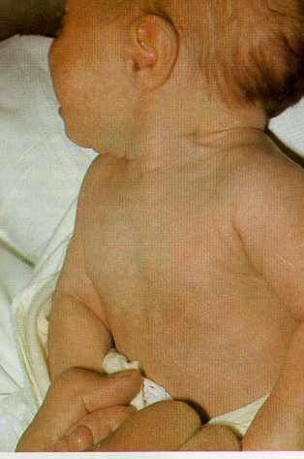
Sternomastoid Tumour
Clinical presentation:
  At 2-3 weeks of age
  Hard swelling within substance
  of sternocleidomastoid
  Infant looks upwards & to opposite side
Management
  Commence physiotherapy as soon as diagnosis is made – up to 1 year
  Surgery if not responding

Slide 23

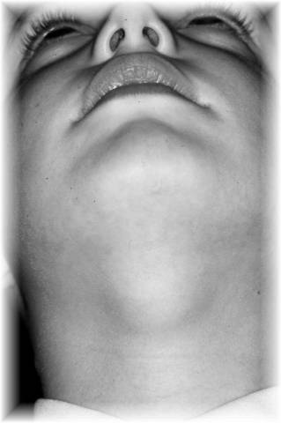
Other neck pathologies
Branchial remnants
  On lateral aspects of the neck.
  Sinuses, fistulae, cysts and cartilaginous elements
Thyroglossal cyst
  Anterior midline. Moves with swallowing,
  tongue protrusion
  Surgery – removal of cyst + body of hyoid + tract
Enlargement of thyroid gland in in some types of
congenital hypothyroidism

Slide 24

Neck pathologies
Cystic hygroma
  Fluid filled lesions
  Lymphatic origin
  Posterior triangle
  Transilluminant
  Management - surgery

Slide 25
Congenital abnormalities of skin

Slide 26
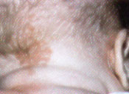
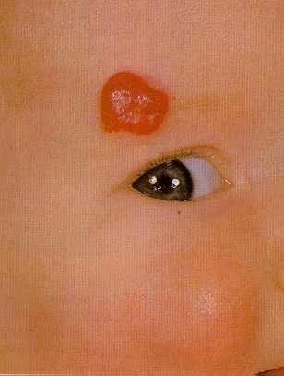
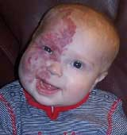
Skin lesions in newborns
Capillary haemangioma / stork bite
Cavernous haemangioma (Strawberry neavus)
Port-wine stain

Slide 27
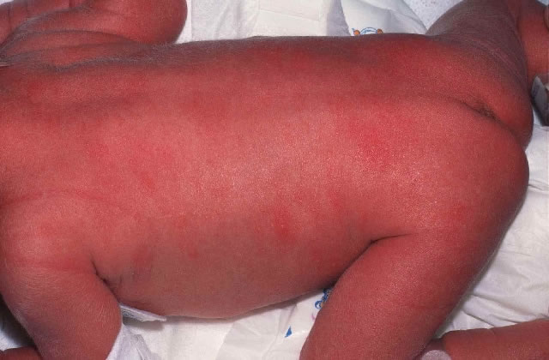

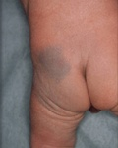
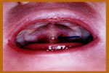
Skin lesions in newborns
Erythema toxicum
Milia
Mongolian blue spot
Epstein’s pearls

Slide 28
Congenital abnormalities of
Cardio-respiratory system

Slide 29
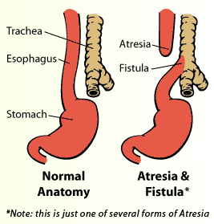
Cardio-Respiratory Abnormalities
Congenital Heart Diseases
Acyanotic Heart Disease
Cyanotic Heart Disease
  Respiratory tract abnormalities
  Choanal atresia
  Diaphragmatic hernia
  Tracheo-oesophageal fistula
  Congenital emphysema

Slide 30
Gastrointestinal tract
  Pyloric stenosis
  Duodenal atresia / intestinal atresia
  Malrotation / volvulus
  Anal atresia
  Gastrochisis / omphalocoele
  Hirschsprung disease
  Anorectal atresia

Slide 31
Congenital abnormalities of the Gastro-intestinal system

Slide 32
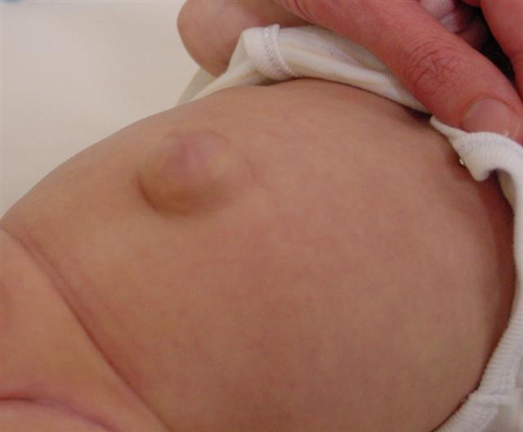
Umbilical abnormalities
Umbilical hernia
Defect of umbilical ring (1-5 cm)
  Usually isolated
  Soft swelling, covered by skin, protrudes during crying
  Consists of omentum/bowel
  Problems – very rare
Most resolve spontaneously by 2 years
Surgical repair
  Persistence of beyond 2 years
  Causes symptoms / becomes strangulated
  Progressively larger after 1-2 years

Slide 33
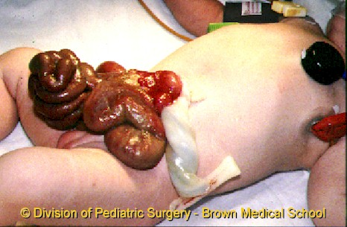
Gastrointestinal abnormalities
Gastroschisis
Complete defect through all layers of anterior abdominal wall; lateral to umbilicus
Unknown aetiology
Bowel not covered
Prevent hypothermia / fluid loss
Transport in plastic bag aseptically

Slide 34

Gastrointestinal abnormalities
Exomphalos
Herniation of intra-abdominal contents through umbilical ring
Failure of gut to return to abdominal cavity in first trimester
Peritoneal / amniotic membrane covering present
Associated with other congenital abnormalities

Slide 35
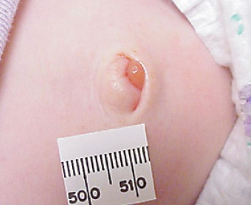
Other umbilical lesions
Umbilical granuloma
  Persistence of granulation tissue after cord separation
  1mm-1cm pink friable lesions at base of umbilicus
  Silver nitrate application usually successful
  Large lesions – surgical
Other umbilical pathologies
  Delayed separation
  Omphalomesenteric remnants
  Urachal remnants

Slide 36
Abnormalities of the Genitourinary tract
  Congenital hydrocoele
  Inguinal hernia
  Crypto-orchidism
  Hypospadias / epispadias
  Labial adhesions

Slide 37
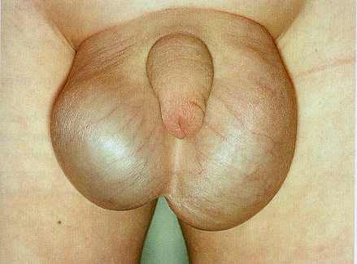
Congenital hydrocele
Accumulation of fluid in tunica vaginalis
  1-2% of male neonates
  Majority non-communicating
  Smooth, non-tender, transillumination present
Most resolve by 12 months
Surgical repair
  Early – if large and tense
  Those persisting beyond 12-18 months

Slide 38
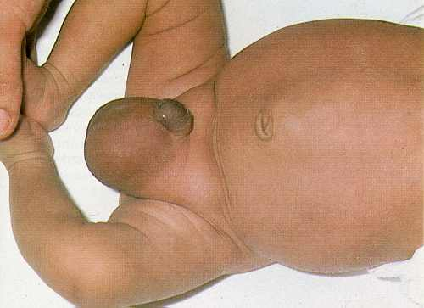
Inguinal hernia
Most congenital indirect hernias caused by a patent processus vaginalis
  Full term: 3.5 -5.0%
  Most present in first 1 year
  Risk factors – prematurity
Problems – incarceration, strangulation, gonadal / bowel infarction
Does not resolve spontaneously
Surgical repair
  Early to avoid complications
  Herniotomy

Slide 39
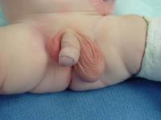
Cryptorchidism
Failure to find one or both testes in the scrotum
  Undescended testes
  Retractile testes
At birth - Cryptorchidism in 4.5%
        30% of preterms
        Bilateral in 10%
Descent - majority spontaneously during first 3 months
Problems - Impairment of fertility, risk of malignancy
- indirect inguinal hernia, torsion, infarction
Management – Orchidopexy at 9-15 months

Slide 40
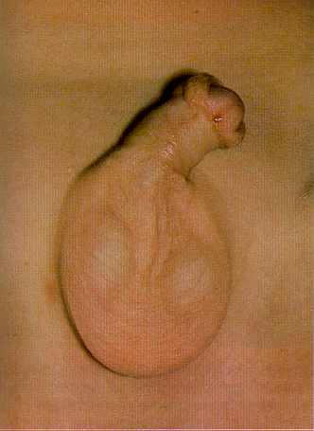
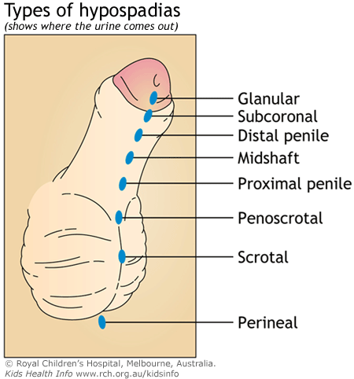
Hypospadias
Urethral opening on ventral surface of penis
  Incomplete development of prepuce
  Some have chordee
Incidence - 1:250 males
        - usually isolated
Problems - deformity of urinary stream
- sexual dysfunction, infertility
Management - Surgical repair at 6-12 months

Slide 41
Congenital abnormalities of the central nervous system

Slide 42
Neurological Abnormalities
  Encephalocoele
  Spina bifida

Slide 43
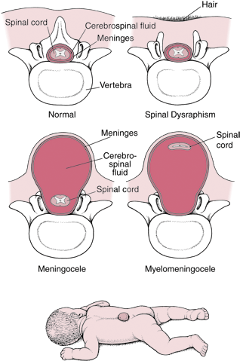
Neural tube defects
Embryology
  Folding over and closing of the neural tube occurs at 3-4 weeks gestation
  Insult at this period –
  anencephaly, encephalocoele, meningocoele, meningomyelocoele, spina bifida occulta
Prevention
  Preconceptional folic acid

Slide 44
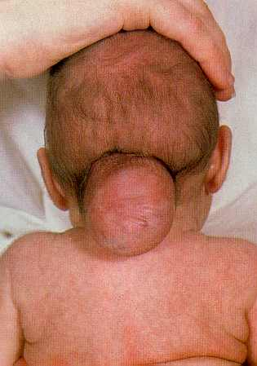
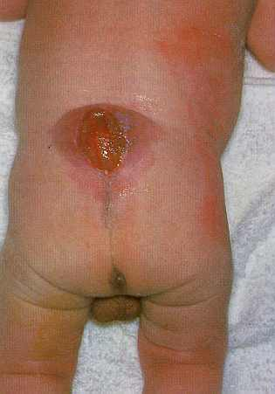
Neural tube defects
Management
  Multi-disciplinary approach
  Surgery – encephalocoele, meningocoele, meningomyelocoele
  Observe for hydrocephalus
  Bladder, bowel; possible intermittent drainage
  Orthopaedic management of limb deformities
  Assessment of cognitive abilities
  Treatment of seizures

Slide 45
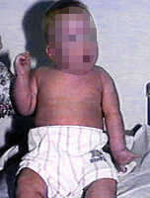
Neurological problems
Erb palsy damage to the upper roots of brachial plexus
  Associated with breech deliveries
  Arm cannot be lifted
  Asymmetrical Moro reflex
  Initial advice on handling the baby
  Later – mainly exercise
  Klumpke palsy – damage to the lower roots of brachial plexus – claw hand

Slide 46
Congenital abnormalities of the limbs

Slide 47
Limb abnormalities
  Developmental dysplasia of the hip
  Talipes equinovarus

Slide 48


Developmental dysplasia of the hip (DDH)
Ortolani and Barlow manoeuvres / tests. Middle finger on the greater trochanter and thumb on the mid-inguinal point
Ortolani test. (A) Initial downward pressure further dislocates the hip, which then (B) relocates as the thigh is abducted. A palpable click will be noted. Indicates a dislocated hip.
Barlow test. (A) The leg is pulled forward and then (B) adducted in an attempt to dislocate the femur. Indicates a dislocatable hip

Slide 49
Developmental dysplasia of the hip (DDH)
At birth
  1: 60 demonstrable hip instability – most stabilize within first few weeks
DDH
  Incidence – 1:1000 live births
  M:F = 1:6
  Usually unilateral; twice as common on left
  Familial history common
  Increased incidence among first born infants in the family
  Breech position in-utero, oligohydramnios
  Spine abnormalities, neuromuscular problems

Slide 50
Developmental dysplasia of the hip (DDH)
Other clinical features
  Limited abduction
  Leg length asymmetry
  Asymmetric skin creases
Investigations
  Ultrasound scan (early)
  Hip radiographs (later)
Early diagnosis is vital
Late diagnosis:
Surgery inevitable
Gait abnormalities
Secondary arthritis / joint
deformity

Slide 51

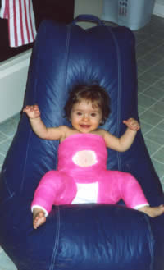
DDH Management
Age | Management
Birth - 3/4 mths | Closed reduction; no sedation Maintain flexion & abduction Pavlik Harness for 12-16 wks
4- 6 months | Examine under anaesthesia Using radiopaque dye in joint If possible closed reduction & immobilisation for 6-9mths (hip spica)
After 12-18 mths | More likely open surgical reduction + IIry surgery (femur, acetabular)
> 3-4 yrs | Surgery more difficult
>8-10 yrs | Surgery extremely difficult If bilateral best left untreated
Plaster of Paris Hip spica cast

Slide 52
Talipes equinovarus (Club foot)
Positional talipes
  Due to position in-utero
  Normal anatomy
Congenital talipes equinovarus
  Incidence – 1-2:1000 live births
  M:F = 2:1
  Bilateral in 50%
  Familial predisposition

Slide 53
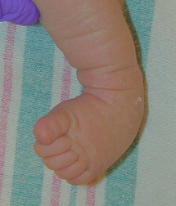
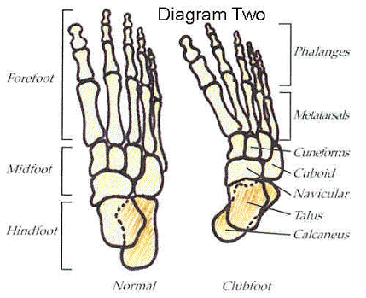
Talipes equinovarus
Anatomical abnormalities
  Hind foot in equinus and varus
  Forefoot adducted & plantar flexed
  Mid calf atrophy
  Variable rigidity
  Medially displaced navicular
Need to rule out
  Neurological causes
  Associations - DDH

Slide 54
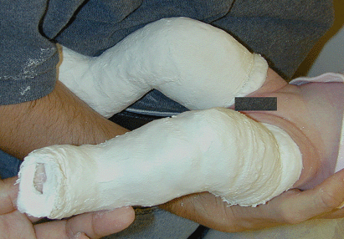
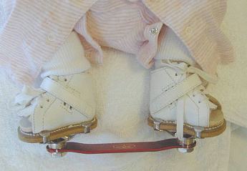
Talipes equinovarus
Management
Conservative – Ponseti method
  Initiated in all
  Ideally immediately after birth
  Stretching, splinting, serial plaster casting
  (Dennis Browne Bar)
Surgical Release tight joint capsules, tendons,
restoration of bone alignment

Slide 55

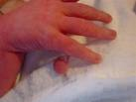
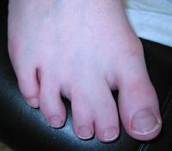
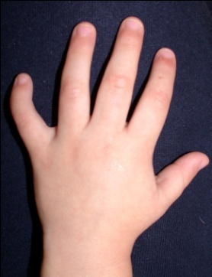
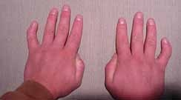
Finger / toe abnormalities
Polydactyly (Extra digits)
Usually 5th toe
Skin tags – near small finger / thumb
Occurs 2:1000 ; 10% family history
Associated syndromes
Syndactyly (webbing)
Usually 2nd & 3rd toes
Associated syndromes
Clinodactyly
Incurving of finger – usually 5th

